Slide 1

Types of Communication in Organization
Unit- 1

Slide 2
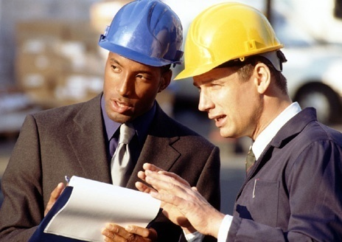
Effective Communication
1
Notes:
What is effective communication?
Communication is the process of sharing information, thoughts and feelings between people through speaking, writing or body language.
Effective communication extends the concept to require that transmitted content is received and understood by someone in the way it was intended. The goals of effective communication include creating a common perception changing behaviors and acquiring information.
“Why is communication so important to a safety program?”
Through a coordinated two-way safety communication program, employees are made aware of safe practices, safety rules and concerns. Their attitude and awareness toward safety improves. Also, two-way communication keeps management informed of the committee’s activities and safety priorities. Good communication also helps the Committee understand its authority and helps management work safety into policies and procedures.

Slide 3
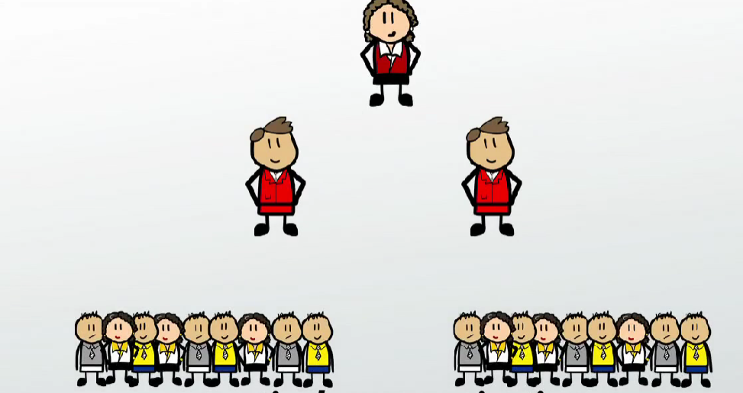

Communication
Communication is a very important part of any organization.
It is process of passing information (sending) and understanding (receiving) the same from one person to another through verbal and non-verbal means.
It takes place among business entities, within markets, various groups of employees, buyers and sellers, service providers and clients, salesperson and prospective buyers, and within the organization and with the press.

Slide 4
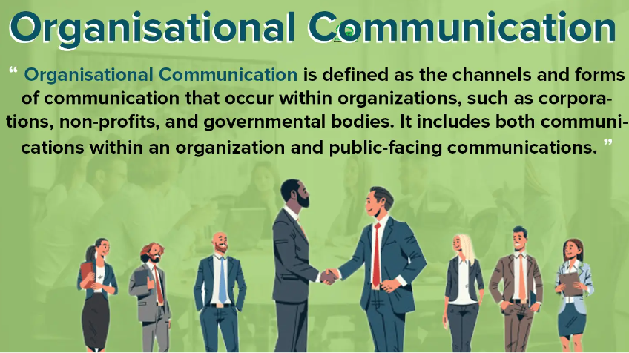

Slide 5
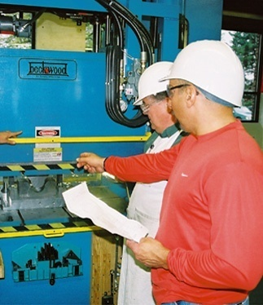
Communication Plan
The elements of an effective communication plan should include a clearly defined:
Receiver
Message
Communication process
Timeframe
Evaluative process
2
Notes:
A communication plan is a written document that describes:
To whom your communications will be addressed (your audience)
What you want to accomplish with your organization’s communications (your objectives)
Ways those objectives can be accomplished (your safety goals)
How you will accomplish your objectives (the tools and timetable), and
How you will measure the results of your program (evaluation)
Questions to think about (from the receivers point of view):
Who makes up my audience? Take some time to think about your audience – the people you are communicating to.
How do they prefer to receive messages?
What are the literacy skills of the audience?
What’s in it for them?

Slide 6
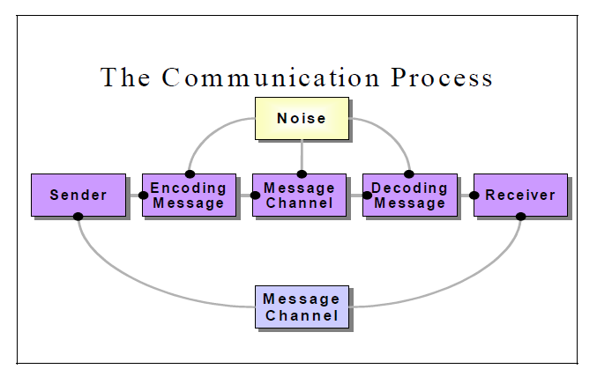
Communication Process
PPT-092-01
3
Notes:
The Communication Process contains:
1. Sender of the message,
2. Recipient of message,
Intervening “static” or “noise” to the means of communication.
At it’s most basic level, communication is the exchange of ideas and feelings between people.
The sender has an idea/thought
The sender encodes the idea as a message in a clear, direct way that allows the receiver to correctly decode the message
The sender transmits the message through a channel (means by which message is sent)
The audience/receiver decodes the message (it is an essential component of effective communication , it requires the receiver to ensure that he/she properly heard and understood the message).
5. The audience provides feedback to the sender
6. The intervening “static” or “noise” to the means of communication (barrier/distraction)

Slide 7
Effective Communication
Why it Matters…
Failure to communicate safety information effectively can have serious negative consequences:
Incidents, injuries, and illness
Lost workdays
Reduced productivity and delays
Risk-taking by employees
Inability to comply with regulations
Higher workers’ compensation and health insurance costs
PPT-092-01
7
Notes:
What was the result of a communication failure you have experienced?
On a typical work day, fourteen people lose their life.
Over a year nearly four million people incur an injury that requires lost time.
This does not include the pain and suffering the employee experiences.
The National Council of Compensation Insurers estimates that as much as 40% of worker’s compensation costs can be linked to how an employer communicates with and responds to worker injuries.

Slide 8
Safety Communication
The main objective of any workplace safety communication or program is to change behavior.
???
How does a safety committee change attitudes toward safety or improve the way people work?
PPT-092-01
8
Notes:
The main objective of any workplace safety communication or program is to change behavior.
Effective safety communication can create an environment where employees have an emotional commitment to the organization and its goals.
How does a safety committee change attitudes toward safety or improve the way people work?
Typically, the objective of safety communication/message is to get employees to stop something (unsafe acts) and start something (following policies and procedures).

Slide 9
Communication Process
Four separate groups of workers seek information differently based on their perceived risk:
Responsive individuals
Avoidant individuals
Proactive individuals
Indifferent individuals
PPT-092-01
13
Notes:
Here are the four “general” ways people perceive risk and seek information in the workplace:
Responsive individuals – those who believe they have a high risk of injury , but also believe they can take an active role in preventing any work-related injuries and are motivated to seek safety information.
Avoidant individuals - those who feel as if they are high risk for injury, but do not take any of the steps needed to address their safety behaviors.
Proactive individuals – those who perceive a low risk for injury, but believe they can prevent any injuries. These individuals are not motivated by their perceived risk as much as they are to remain injury free.
Indifferent individuals – those who do not believe they have any risk of injury, or the ability to prevent such injuries.

Slide 10

Communication Process
Effective communication increases motivation
The more people a “communication” goes through, the more distorted it becomes
Effective communication reaches the heart as well as the mind
Use it or lose it
PPT-092-01
16
Notes:
Safety Communication Reminders:
Effective communication increases motivation
The more people a “communication” goes through, the more distorted it becomes
Effective communication reaches the heart as well as the mind
Use it or lose it (maintain good habits)

Slide 11
Internal Communication
Internal communication takes place within the organization or group–among people within, among different groups of employees and between employers and employees.
It could be oral or written, visual or audio-visual, formal or informal, and upward or downward.
Internal communication serves to inform, instruct, educate, develop, motivate, persuade, entertain, direct, control and caution people in the organization.

Slide 12
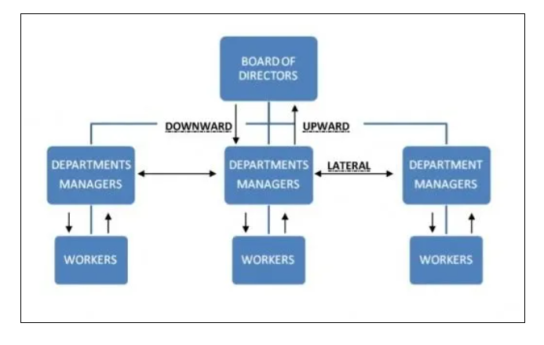
Communication

Slide 13
External Communication
Unlike internal communication, external communication flows outward.
It addresses people outside the organization, like the prospective customers, competitors, public, press, media and the government.
External communication can take place in various ways and through different channels.

Slide 14
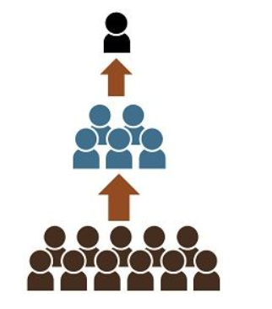
Upward Communication
Large organizations have different hierarchical levels or tiers.
Banks, finance companies, insurance businesses, and such other people-oriented organizations have typically a 3-tier or a 4-tier structure.
The to be complete and effective should encompass all these levels and tiers.
Upward communication is one which moves upward, i.e., from bottom to top levels in the hierarchy.

Slide 15
Any communication that moves from
Employees to supervisors
supervisors to managers
managers to executives
regional manager to general manager and so on, maybe categorized as upward communication.

Slide 16
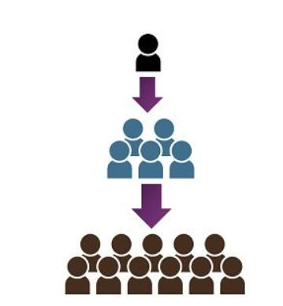
Downward Communication
Downward communication moves from top to the bottom, i.e. from the CEO downwards.
It travels through senior executives to junior level functionaries, from the controlling office to the branch, from the head of the division to the head of the unit.

Slide 17
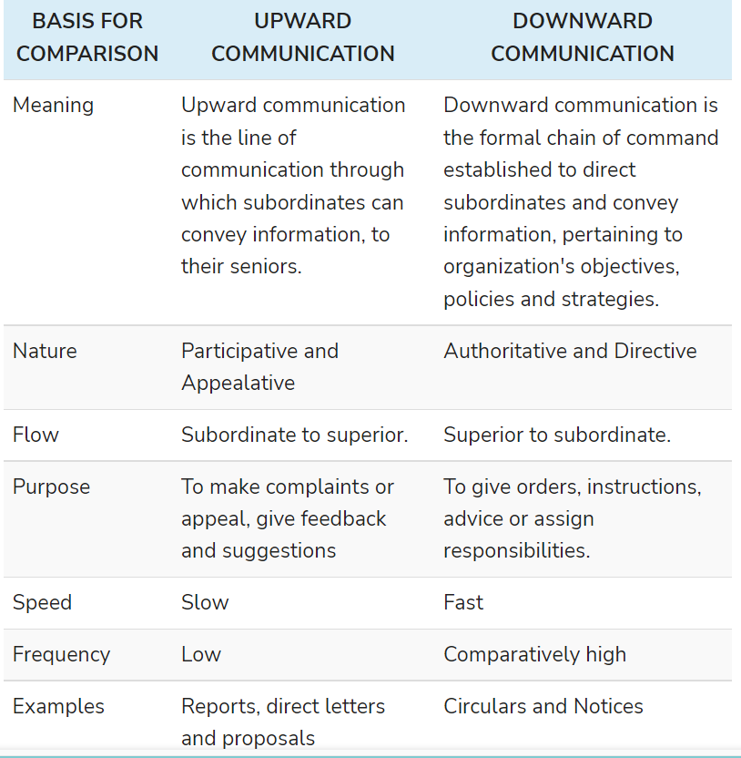
Upward vs Downward

Slide 18
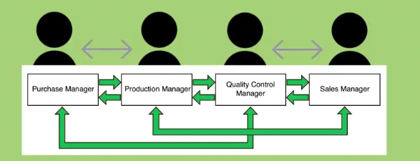
Types
Formal Communication - Towards ensuring communication on an on-going basis, organizations develop formal systems.
Informal Communication - This type of communication takes place in an unstructured manner and outside the formal forums. There is an element of spontaneity in this communication.
Lateral Communication- Lateral communication generally takes place in an organization and is neither upward nor downward. It proceeds in a horizontal manner and takes place among equals and at peer level

Slide 19
Interactive Communication- Interactive communication is essentially a two-way process. It takes place through meetings, conferences, teleconferencing, multimedia presentations, group discussions
Mass Communication- Mass communication is distinctive in view of its scale. Essentially, it addresses a large mass of people. Public speaking, newspapers, magazines and journals, radio, television, dotcoms, etc. are channels of mass communication
Grapevine- Grapevine is a kind of informal communication that prevails in organizations and businesses. The source of such communication may not be clear. It spreads by way of gossip and rumors.

